Slide 1
Cloud storages

Slide 2
Cloud storage is a model of computer data storage in which the digital data is stored in logical pools, said to be on "the cloud". The physical storage spans multiple servers (sometimes in multiple locations), and the physical environment is typically owned and managed by a hosting company. These cloud storage providers are responsible for keeping the data available and accessible, and the physical environment secured, protected, and running. People and organizations buy or lease storage capacity from the providers to store user, organization, or application data.
Cloud storage services may be accessed through a colocated cloud computing service, a web service application programming interface (API) or by applications that use the API, such as cloud desktop storage, a cloud storage gateway or Web-based content management systems.

Slide 3
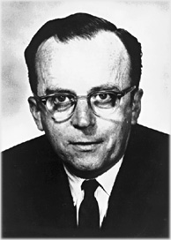
History
Cloud computing is believed to have been invented by Joseph Carl Robnett Licklider in the 1960s with his work on ARPANET to connect people and data from anywhere at any time.
In 1983, CompuServe offered its consumer users a small amount of disk space that could be used to store any files they chose to upload.
In 1994, AT&T launched PersonaLink Services, an online platform for personal and business communication and entrepreneurship. The storage was one of the first to be all web-based, and referenced in their commercials as, "you can think of our electronic meeting place as the cloud." Amazon Web Services introduced their cloud storage service AWS S3 in 2006, and has gained widespread recognition and adoption as the storage supplier to popular services such as SmugMug, Dropbox, and Pinterest. In 2005, Box announced an online file sharing and personal cloud content management service for businesses.

Slide 4
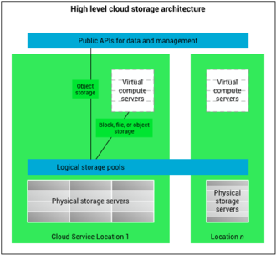
Architecture
Cloud storage is based on highly virtualized infrastructure and is like broader cloud computing in terms of interfaces, near-instant elasticity and scalability, multi-tenancy, and metered resources. Cloud storage services can be used from an off-premises service (Amazon S3) or deployed on-premises (ViON Capacity Services).
There are three types of cloud storage: a hosted object storage service, file storage, and block storage. Each of these cloud storage types offer their own unique advantages.
Examples of object storage services that can be hosted and deployed with cloud storage characteristics include Amazon S3, Oracle Cloud Storage and Microsoft Azure Storage, object storage software like Openstack Swift, object storage systems like EMC Atmos, EMC ECS and Hitachi Content Platform, and distributed storage research projects like OceanStore and VISION Cloud.
Examples of file storage services include Amazon Elastic File System (EFS) and Qumulo Core, used for applications that need access to shared files and require a file system. This storage is often supported with a Network Attached Storage (NAS) server, used for large content repositories, development environments, media stores, or user home directories.
A block storage service like Amazon Elastic Block Store (EBS) is used for other enterprise applications like databases and often require dedicated, low latency storage for each host. This is comparable in certain respects to direct attached storage (DAS) or a storage area network (SAN).

Slide 5
Hybrid cloud storage
Hybrid cloud storage is a term for a storage infrastructure that uses a combination of on-premises storage resources with cloud storage. The on-premises storage is usually managed by the organization, while the public cloud storage provider is responsible for the management and security of the data stored in the cloud.[33] Hybrid cloud storage can be implemented by an on-premises cloud storage gateway that presents a file system or object storage interface which the users can access in the same way they would access a local storage system. The cloud storage gateway transparently transfers the data to and from the cloud storage service, providing low latency access to the data through a local cache.[21]

